Slide 1
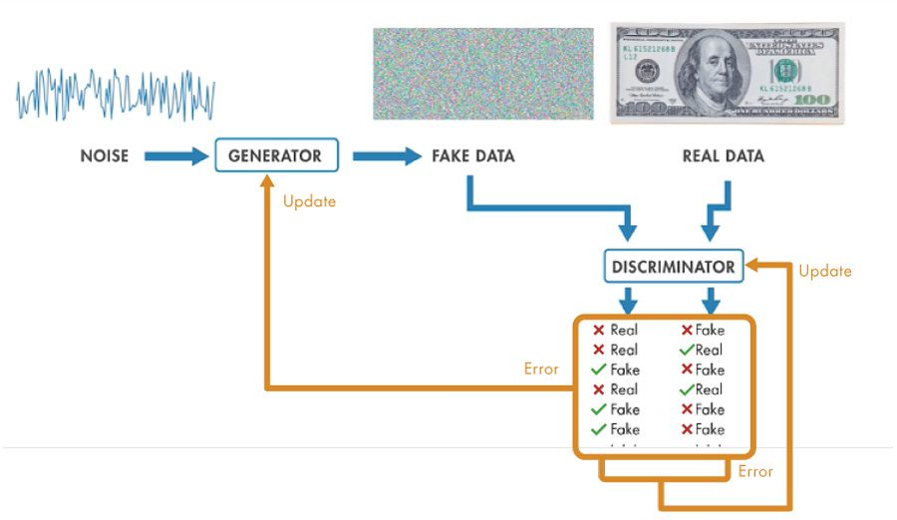
Introduction to Generative Adversarial Networks

Slide 2
Table of content
Generative Adversarial Networks (GANs)
Train a GAN
Generate fake data
Discriminate real/fake images
Update parameters
Applications of Generative Adversarial Networks
Face synthesis

Slide 3
Generative adversarial networks (GANs)
Generative adversarial networks (GANs) are a type of deep neural network used to generate synthetic data (synthetic images of faces, new songs in a certain style, or text)
GAN architecture comprises of two deep neural networks:
The generator generates new data instances
the discriminator decides whether each instance of data is “real” from the training dataset, or “fake” from the generator
The generator and discriminator are trained to work against each other in an “adversarial” manner
The goal of the training is that the generator can create realistic synthetic data that the discriminator can no longer determine is fake
Notes:
Generative adversarial networks (GANs) are a type of deep neural network used to generate synthetic signals. The architecture comprises two deep neural networks, a generator and a discriminator, which work against each other (thus, “adversarial”). The generator generates new data instances, while the discriminator evaluates the data for authenticity and decides whether each instance of data is “real” from the training dataset, or “fake” from the generator.
Together, the generator and discriminator are trained to work against each other until the generator is able to create realistic synthetic data that the discriminator can no longer determine is fake. After successful training, the data produced by the generator can be used to create new synthetic data, for potential use as input to other deep neural networks.
GANs are versatile in that they can learn to generate new instances of any datatype, such as synthetic images of faces, new songs in a certain style, or text

Slide 4
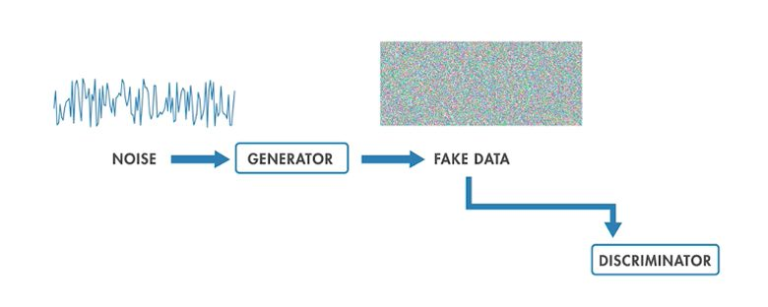
Training a GAN: generate fake data
Noise is fed into the generator. Since the generator hasn’t been trained yet, the output will look like noise in the beginning
Notes:
Using an example of creating synthetic images of money, let’s walk through the specific parts and functions of a GAN architecture.
Noise is fed into the generator. Since the generator hasn’t been trained yet, the output will look like noise in the beginning.

Slide 5
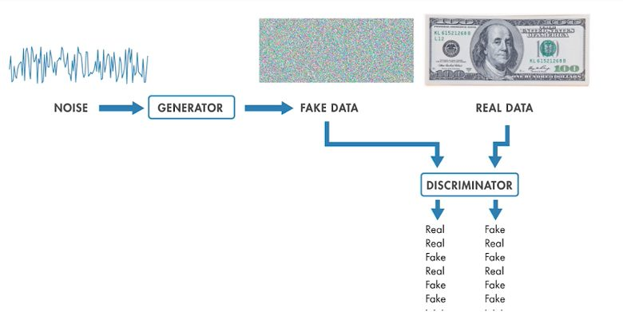
Training a GAN: discriminate real/fake images
Training data and the output of the generator is sent to the discriminator, which is being trained in parallel to identify real/fake images
Notes:
Training data and the output of the generator is sent to the discriminator, which is being trained in parallel to identify real/fake images. The output of the discriminator at the beginning will not be very accurate as this portion of the network is also being trained and accuracy will improve over time.

Slide 6
Training a GAN: update parameters
The output of the discriminator can be fed back to the generator and the discriminator, to update parameters and attempt to improve on the accuracy.
Notes:
Feedback: The output of the discriminator can be fed back to the generator and the discriminator, which can use this information to update parameters and attempt to improve on the accuracy.
The goal of the discriminator, when shown an instance from the true dataset, is to recognize those images that are authentic. Meanwhile, the generator is creating new, synthetic images that it passes to the discriminator. It does so in the hopes that they, too, will be deemed authentic, even though they are fake. The goal of the generator is to generate passable images: to lie without being caught. The goal of the discriminator is to identify images coming from the generator as fake.

Slide 7
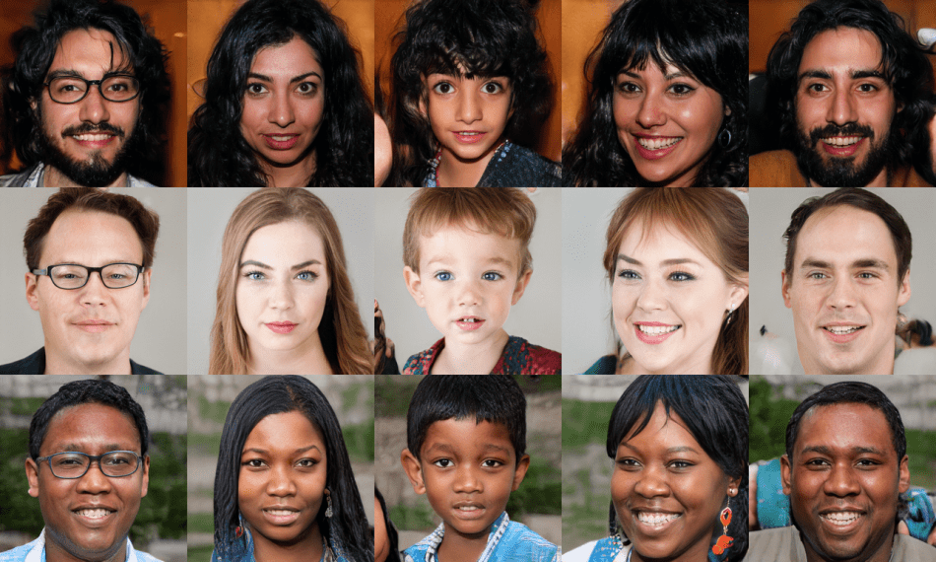
Applications of Generative Adversarial Networks: Face Synthesis
With a GAN we can generate synthetic images
One popular application is to create novel human-like face or modify face characteristics
Notes:
A GAN model can be trained to generate a synthetic image or audio.
A popular application is to generate almost a human-like face if trained sufficiently.
This technology can be used for many good things. However, the potential for bad is there as well. Imagine the impact of an article would have had if it had contained “false images” or “false audio”.

Slide 8
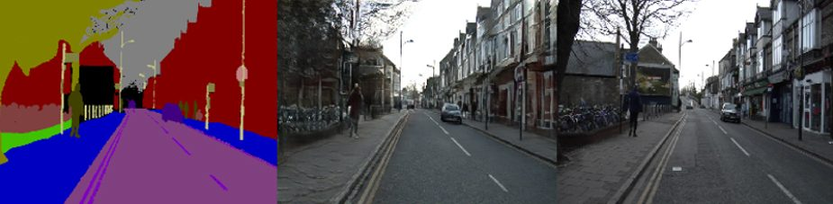
Applications of Generative Adversarial Networks: Scene Generation
Conditional GANs are a specific type of GANs which take advantage of labels
They can be used in applications such as scene generation
Notes:
Conditional GANs are a specific type of GAN takes advantage of labels, while the original GAN does not assume labels will be present. Conditional GANs can be used in applications such as scene generation, where there must be a certain organization to the information. Take the example of scene generation for automated driving. The road and sidewalk must be located below the buildings and sky. A synthetic image created for this example that does not adhere to the location of the road will immediately be determined as fake and unusable in an automated driving application.

